Slide 1





PORTOFOLIO
DATA SCIENCE
Iris Classification
Machine Learning
Presented by:
HENGKORO ARKAN .W
https://github.com/Hengkoro20

Slide 2


Exercise
Create a simple machine learning (classification) program using a dataset that has already been provided by scikit-learn. You can access it at the following link:
https://scikit-learn.org/1.5/datasets/toy_dataset.html
You are free to use any algorithm. You can learn about classification algorithms at the following link:
https://www.geeksforgeeks.org/top-6-machine-learning-algorithms-for-classification/

Slide 3


TOOLS

Slide 4
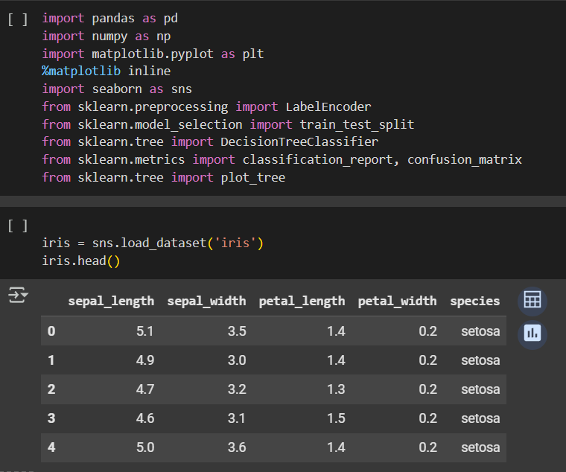

IMPORT
LIBRARY
Imports several libraries like pandas, numpy, matplotlib.pyplot, seaborn, and various modules from sklearn for preprocessing, splitting data, training a decision tree classifier, and generating reports.
Loads the Iris dataset using sns.load_dataset('iris') and displays the first five rows of the dataset using iris.head()

Slide 5
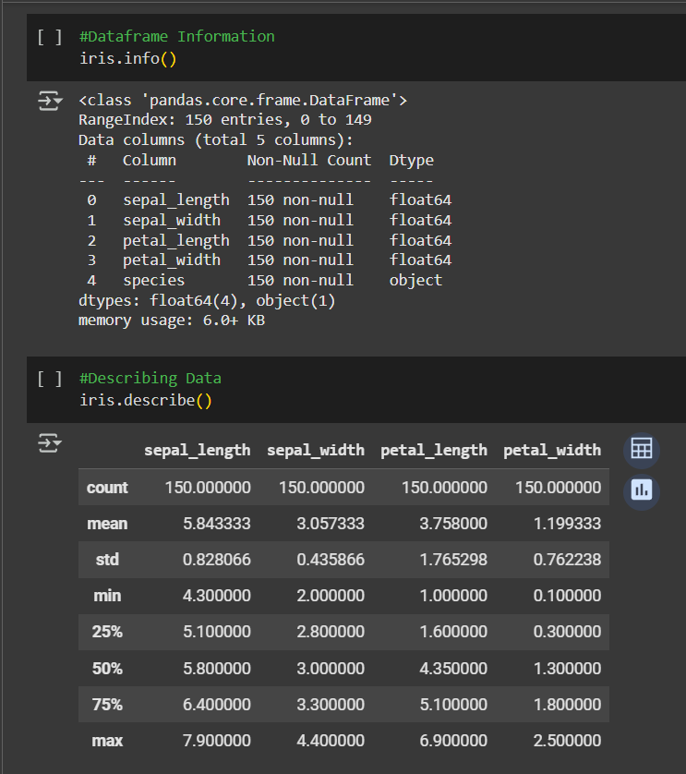
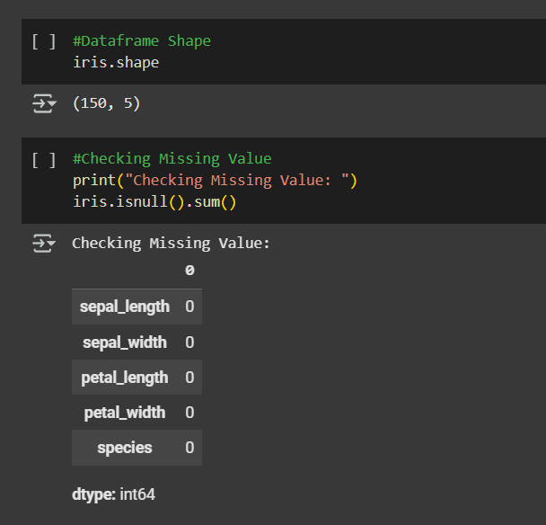
EXPLANATORY DATA ANALYSIS

Slide 6

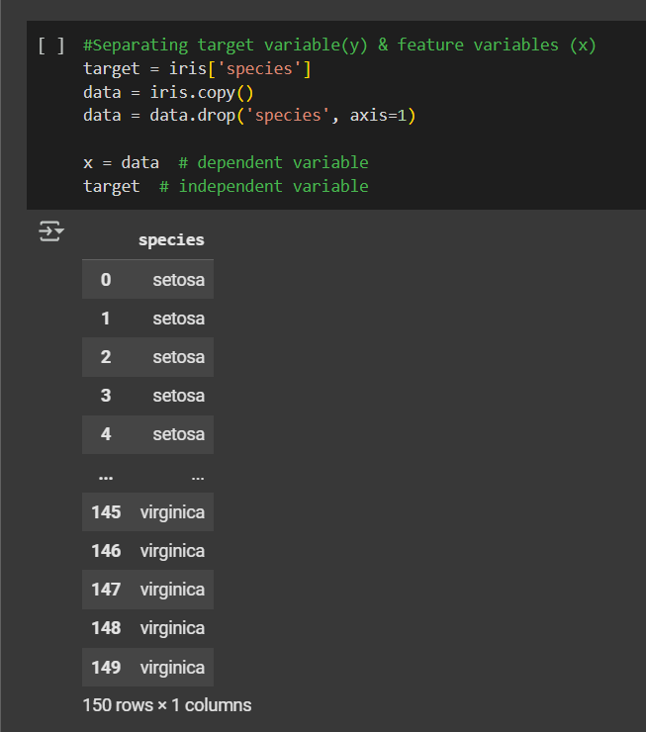
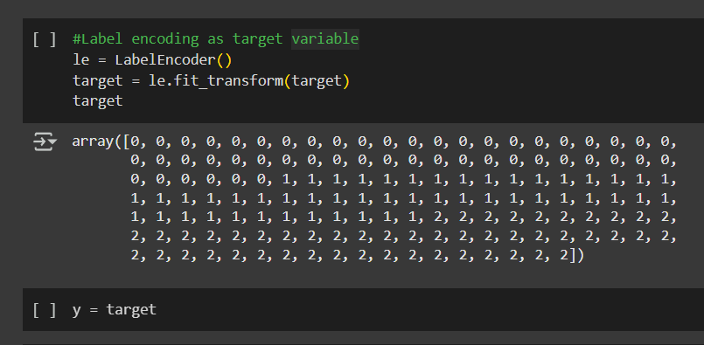
PREDICTING TARGET VARIABLE

Slide 7
TRAINING DATASET

Slide 8
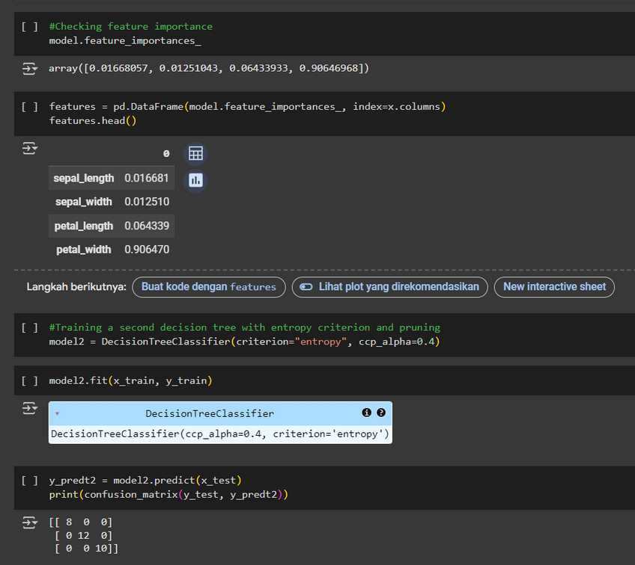
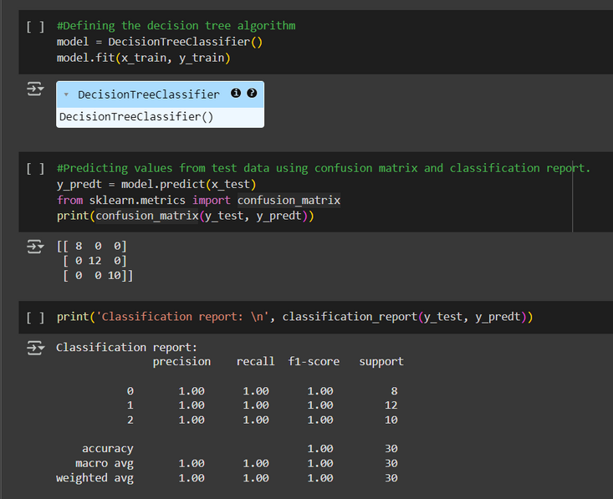
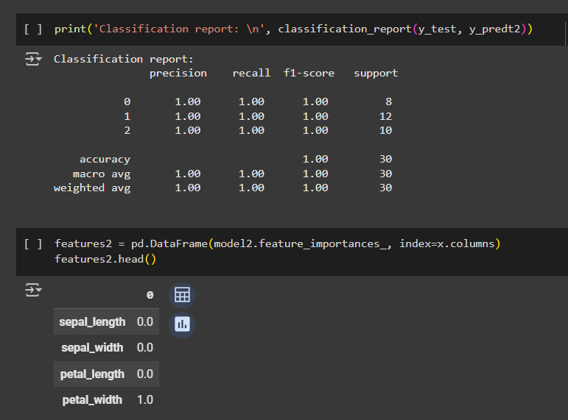
DECISION TREE CLASSIFIER

Slide 9
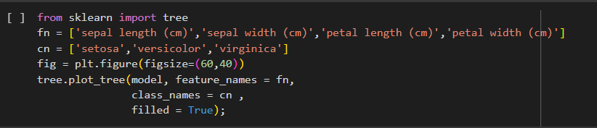
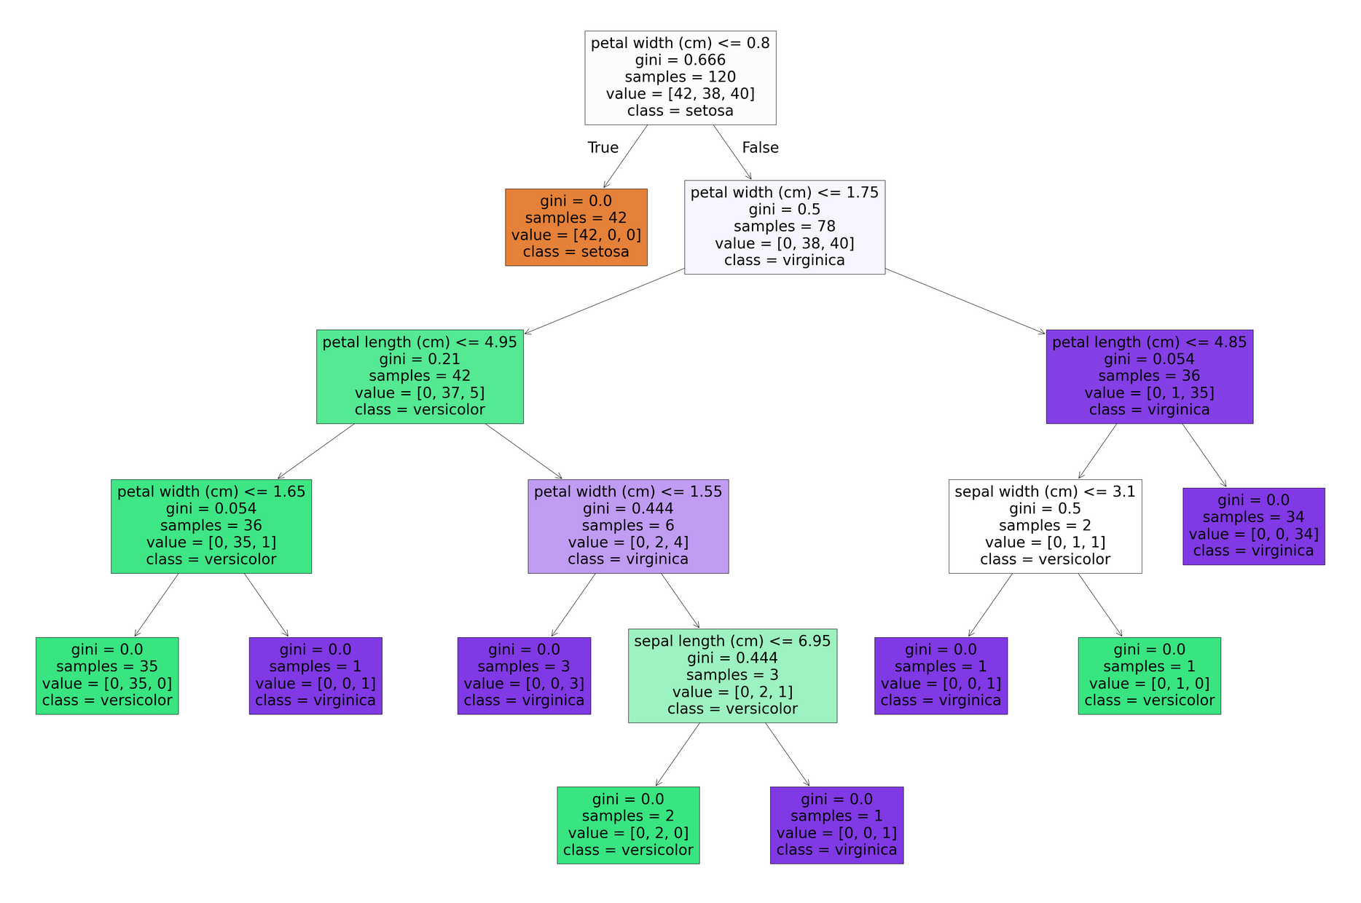
VISUALIZING
Visualizes a decision tree model using sklearn. It defines feature names (fn) and class names (cn) for the dataset, creates a large figure (60x40 inches), and uses tree.plot_tree() to display the tree. The visualization includes feature splits, class labels, and filled nodes, showing how the model classifies data into flower species (setosa, versicolor, virginica).

Slide 10
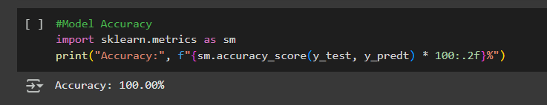
CHECKING ACCURACY
The code calculates and displays the accuracy of a machine learning model using the accuracy_score function from sklearn.metrics. It compares the true labels (y_test) with the predicted labels (y_predt), multiplies the result by 100 to convert it into a percentage, formats it to two decimal places, and prints it in a readable format. Accuracy represents the proportion of correct predictions made by the model.

Slide 11



Thank You For Attention
https://github.com/Hengkoro20
hengkorowicaksono@gmail.com
+62 812 2611 1020

